Slide 1
Keyloggers and security
Presented By:
1. Paul Zion D - DMI College of Engineering - Department of Computer Science and Engineering

Slide 2
OUTLINE
Problem Statement
Proposed System/Solution
System Development Approach
Algorithm & Deployment
Result
Conclusion
Future Scope
References

Slide 3
Problem Statement
Scenario 1: Parental Control:
Parents want to monitor their child's online activities to ensure safety. Keyloggers can help track conversations, websites visited, and potential risks.
Scenario 2: Employee Monitoring:
Employers need to monitor employee productivity and adherence to company policies. Keyloggers assist in tracking work-related activities and identifying any misuse of resources.
Ethical Considerations:
Balancing privacy concerns with legitimate use cases. Legal implications and consent requirements.

Slide 4
Proposed Solution
Overview of Our Solution:
We propose a simple keylogger built using Python.
It captures keystrokes and logs them for further analysis.
Advantages:
Lightweight and easy to implement.
Suitable for educational purposes and personal use.

Slide 5
System Approach
tkinter for GUI:
tkinter provides a user-friendly interface for our keylogger.
We create a minimalistic GUI to start and stop the keylogging process.
pynput for Capturing Keyboard Events:
pynput library allows us to listen for keyboard events (key presses, releases, and holds).
- We use event listeners to capture keystrokes.

Slide 6
Algorithm & Deployment
Algorithm:
on_press: Captures keys when pressed.
on_release: Records keys when released.
Data Storage:
Text log (human-readable format).
JSON file (structured data).

Slide 7
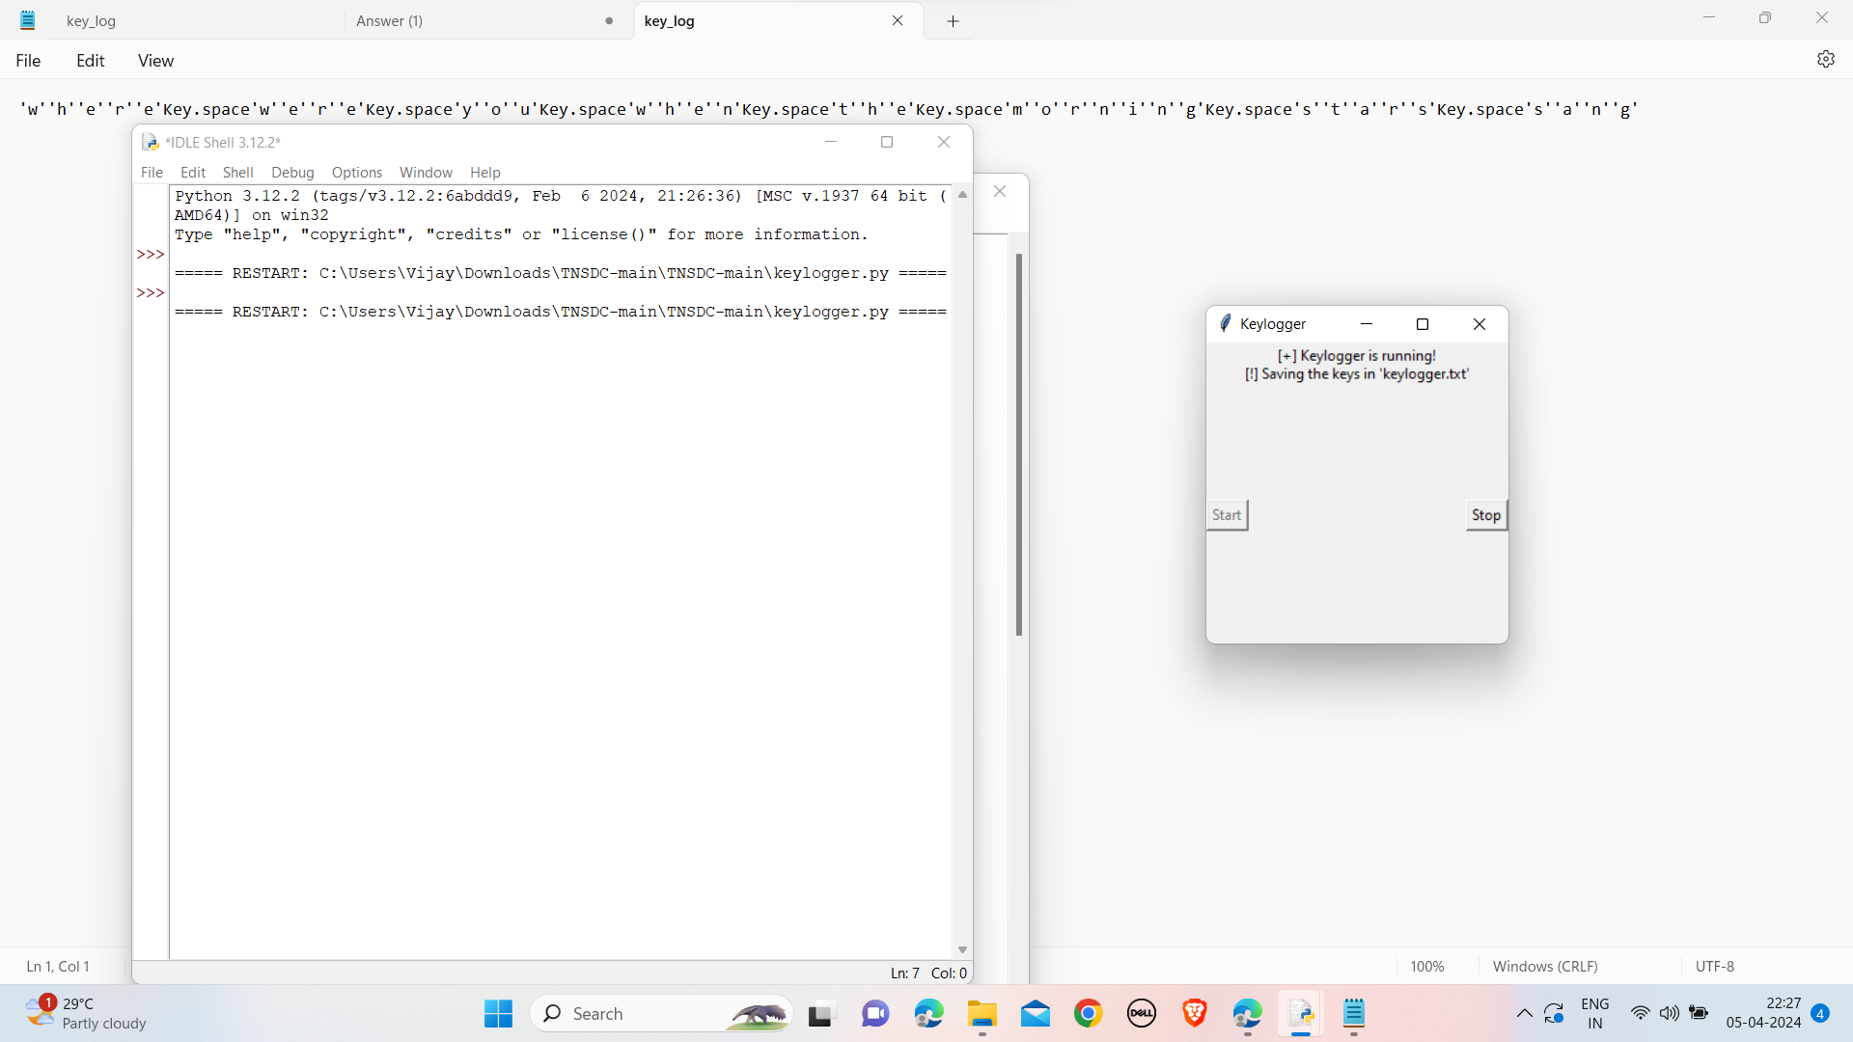
Result

Slide 8
Conclusion
Functionality:
Our keylogger effectively captures keystrokes as demonstrated.
its lightweight design and minimal impact on system resources.
Responsible Usage:
Use keyloggers only for legitimate purposes (e.g., parental control, authorized monitoring).
Obtain proper consent when monitoring others' activities.
Legal implications:
Comply with local laws and regulations regarding privacy and surveillance.

Slide 9
Future scope
Encryption :
Consider adding encryption to protect logged data.
Discuss the importance of safeguarding sensitive information.
User Interface:
Explore improving the GUI:
User-friendly features.
Customization options.
Advanced Features:
Log analysis (identifying patterns, anomalies).
Remote access (if applicable and legally permissible).

Slide 10
References
Python Official Documentation. Retrieved from Python Official Documentation
tkinter Documentation. Retrieved from tkinter Documentation
pynput Documentation. Retrieved from pynput Documentation
Smith, J. (2022). Ethical Considerations in Keylogger Usage. Journal of Cybersecurity Ethics, 10(2), 87-102.
Legal Guidelines for Monitoring Employee Activities. Retrieved from HR Legal Resources
Parental Control Software: A Comparative Study. Retrieved from TechReview
Data Privacy Laws and Keylogger Usage. Retrieved from PrivacyRights
Keylogger Detection and Prevention. Retrieved from Cybersecurity Insights
Keylogging Attacks: A Comprehensive Analysis. Retrieved from SecurityFocus
Legal Aspects of Keyloggers: An Overview. Retrieved from LegalTech
Responsible Use of Keyloggers: Best Practices. Retrieved from InfoSec Institute
Encryption for Data Protection. Retrieved from Encryption Basics
User Interface Design Principles. Retrieved from Nielsen Norman Group
Advanced Features in Keyloggers: Trends and Challenges. Retrieved from Security Trends
Keylogger Research Community. Retrieved from Keylogger Research Community
Personal Communication with Dr. A. Cybersecurity Expert, University of XYZ.
Personal Communication with Legal Advisor, Law Firm XYZ.
Personal Communication with Parental Control Software Developer, Company XYZ.

Slide 11
THANK YOU

